Slide 1
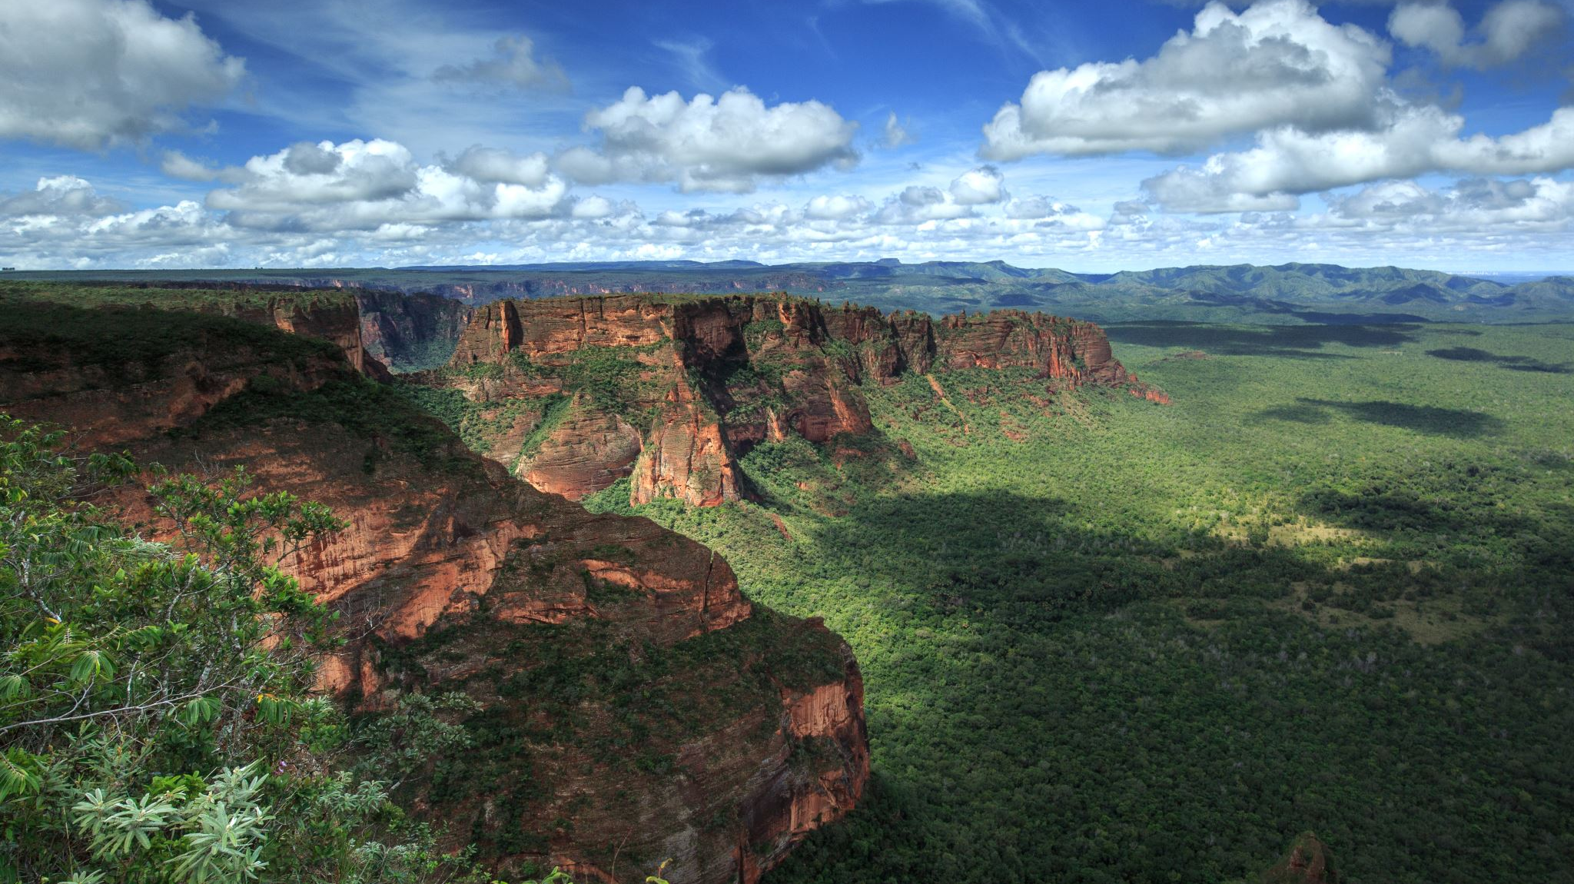
Jane Mburu
Pima Indians Diabetes Project

Slide 2
Primary Objectives
Explore and visualize the dataset to understand the distribution and relationships among variables.
Apply various machine-learning models to predict diabetes and evaluate their performance.
Identify the best-performing model based on accuracy, precision, recall, and F1-score.

Slide 3
Methodology
Loading dataset on Python.
Perform data cleaning.
Perform Exploratory Data Analysis (EDA).
Create visuals using various Python libraries.
Perform predictive analysis using various classification models.
Recommendations

Slide 4
Insights drawn from EDA
Pima Indians Diabetes Dataset

Slide 5
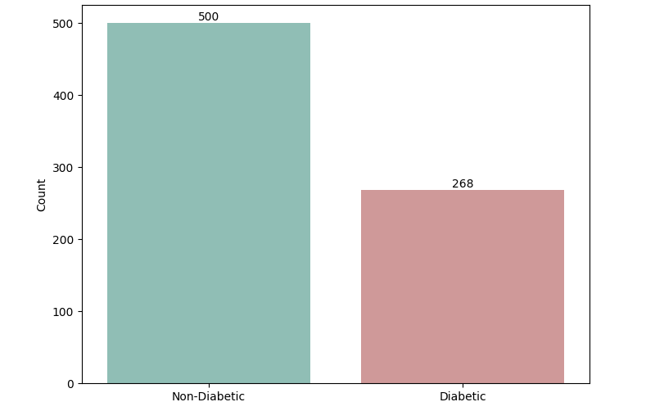
Count of Diabetic/Non-Diabetic Patients
From the dataset, about 500 patients are non-diabetic, while about 268 are diabetic.

Slide 6
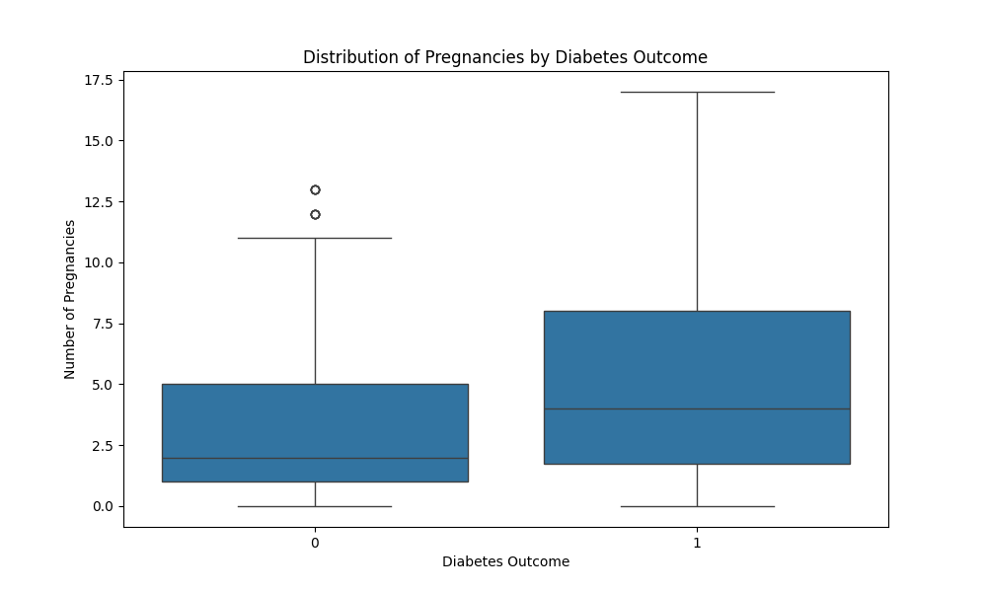
Pregnancies vs. Diabetes Outcome
Patients with fewer pregnancies tend to show the outcome “0” (indicating no diabetes).
Conversely, patients with a higher number of pregnancies tend to exhibit the outcome “1”(indicating diabetes).

Slide 7
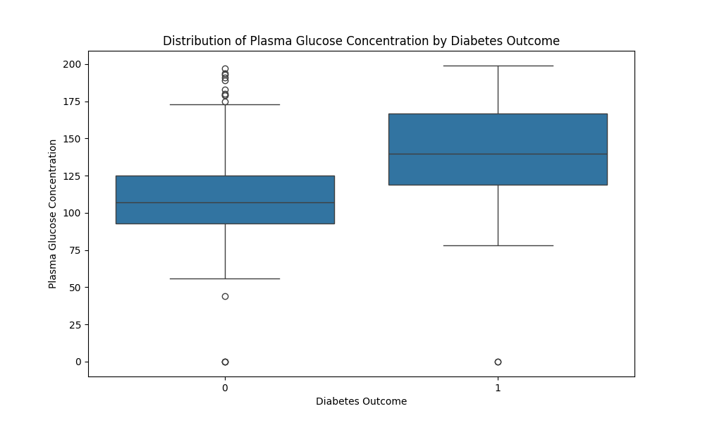
Glucose vs. Diabetes Outcome
Patients with low glucose count tend to show an outcome “0”(no diabetes).
Patients whose glucose count is high tend to show the outcome “1”(diabetic).

Slide 8
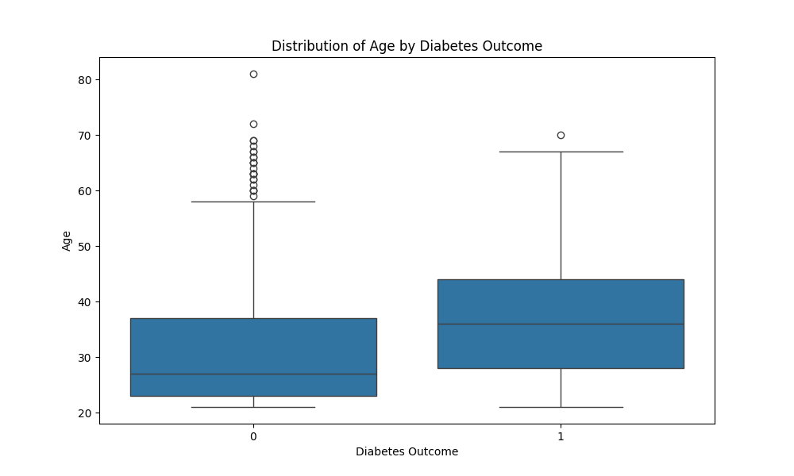
Age vs. Diabetes Outcome
Patients who do not have diabetes (outcome”0”) tend to be younger on average (mean age of 27).
Patients who have diabetes (outcome “1”) are generally older on average (mean age of 36).

Slide 9
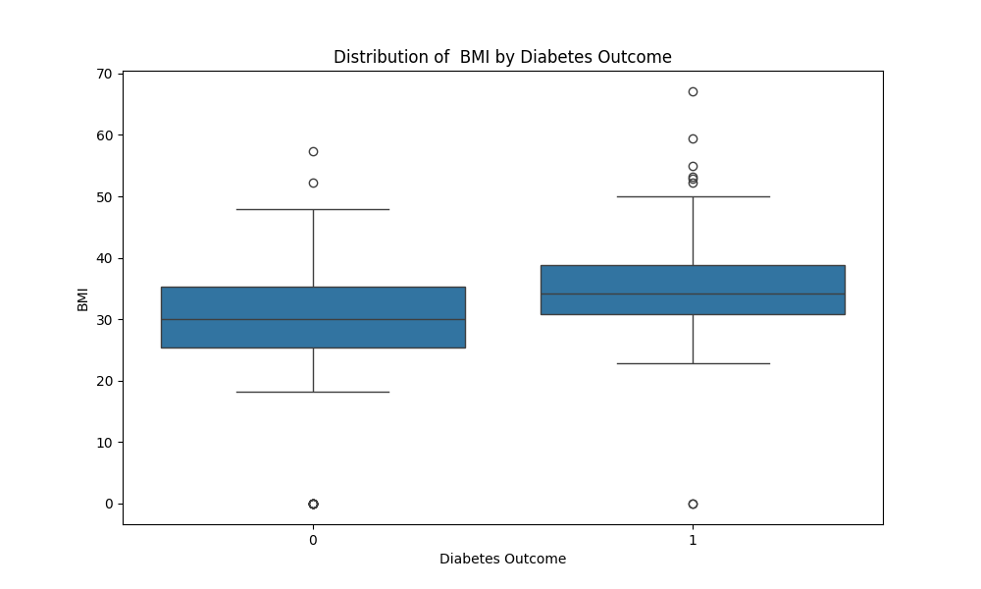
BMI vs. Diabetes Outcome
Patients who do not have diabetes (outcome “0”) tend to have a smaller BMI on average (mean BMI of 30).
Patients who have diabetes (outcome “1”) generally have a higher BMI on average (mean BMI of 34).

Slide 10
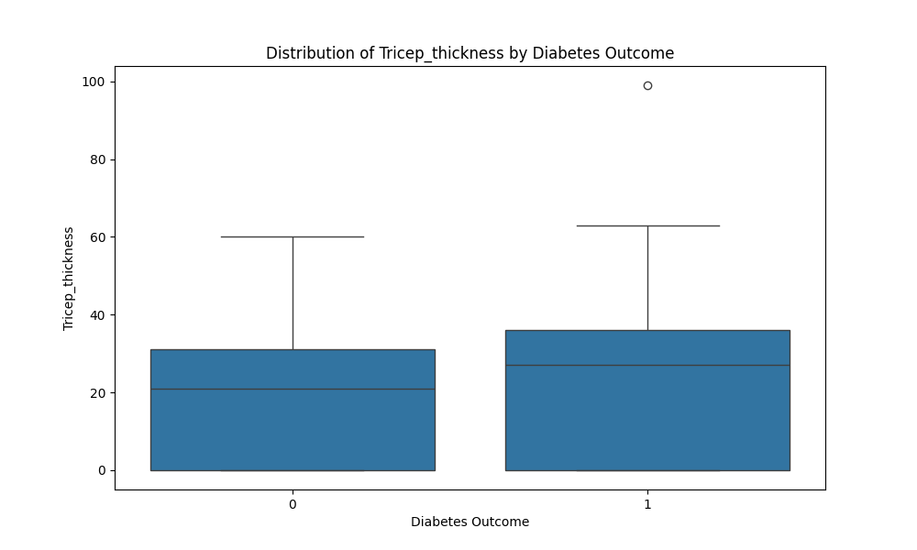
Triceps-Thickness vs. Diabetes Outcome
Patients who do not have diabetes(outcome “0”) tend to have a smaller Triceps thickness on average (mean of 21).
Patients who have diabetes(outcome “1”) generally have a larger Triceps thickness on average (mean of 27.6).

Slide 11
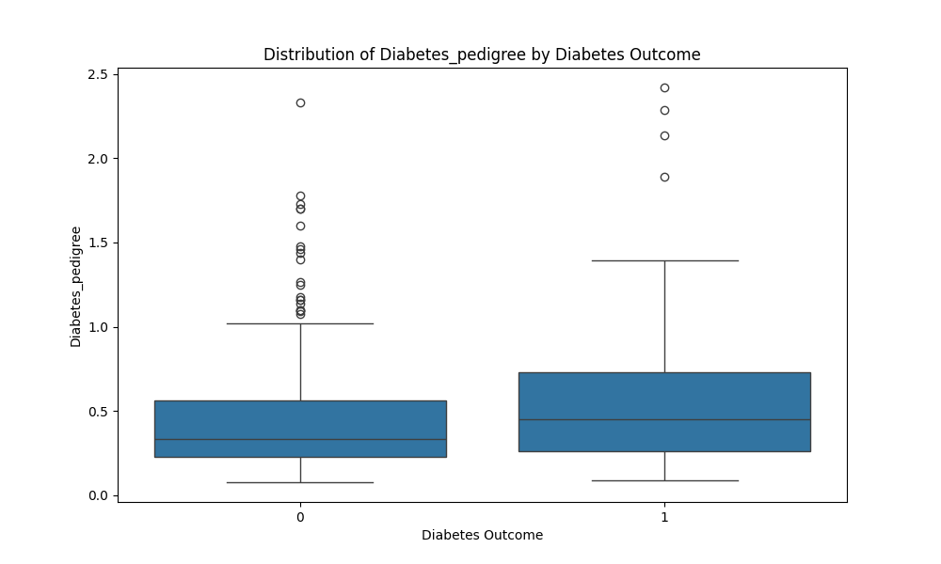
Diabetes Pedigree vs. Outcome
Patients who do not have diabetes (outcome “0”) tend to have a smaller Diabetes Pedigree on average (mean Diabetes Pedigree = 0.346).
Patients who have diabetes (outcome “1”) generally have a larger Diabetes Pedigree on average (mean Diabetes Pedigree = 0.452).

Slide 12
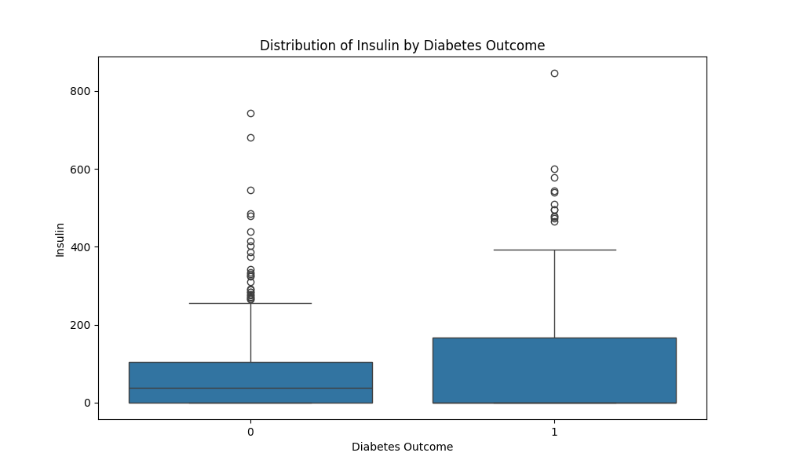
Insulin vs. Diabetes Outcome
Patients with an insulin level of 35 tend to be non-diabetic (outcome “0”).
Patients with an insulin level of 0 tend to be diabetic (outcome “1”).

Slide 13
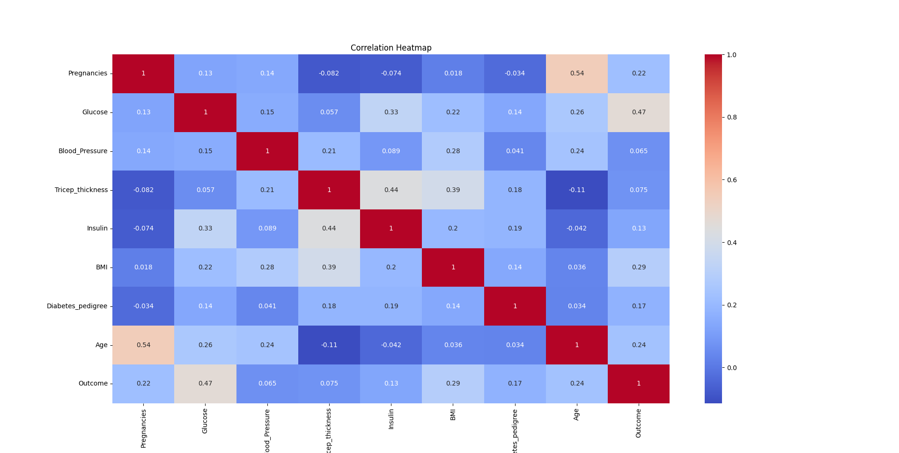
Correlation Heat Map
High positive correlations are represented by warmer colors; high negative by cooler colors; and no correlations by neutral colors.

Slide 14
Predictive Analysis
Classification

Slide 15
Machine Learning Models Used
Utilized different algorithms to compare and determine which one performs better. These include:
Decision Tree Classifier
Logistic Regression
Support Vector Machine (SVM)
Random Forest
K-Nearest Neighbors (KNN)

Slide 16
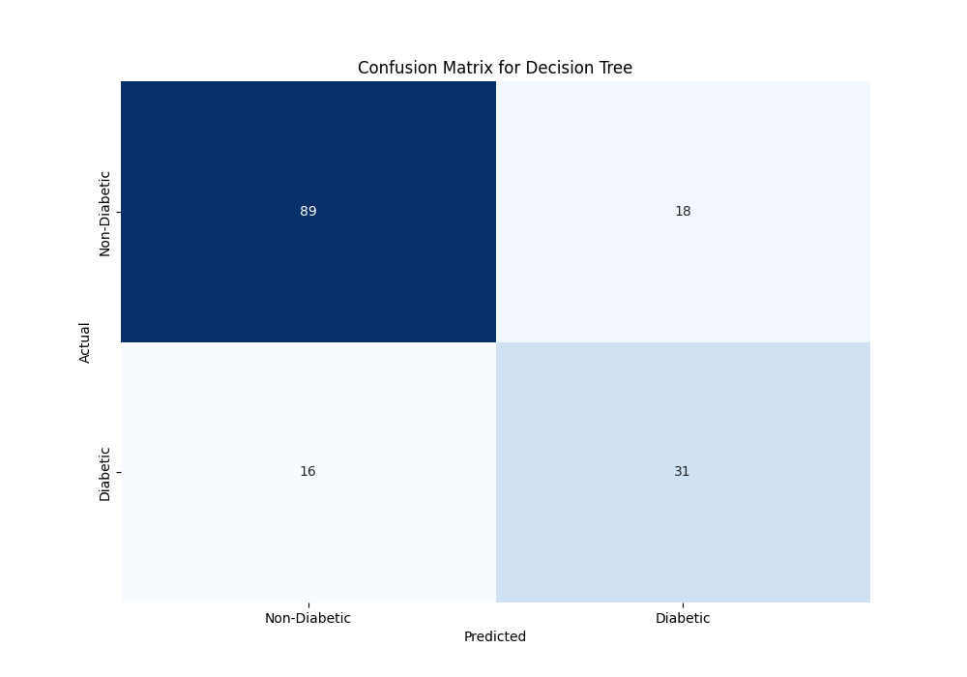
Confusion Matrix for Decision Tree
 | Precision | Recall | F1-score | Support
0 | 0.85 | 0.83 | 0.84 | 107
1 | 0.63 | 0.66 | 0.65 | 47
Accuracy |  |  | 0.78 | 154
Macro Avg | 0.74 | 0.75 | 0.74 | 154
Weighted Avg | 0.78 | 0.78 | 0.78 | 154

Slide 17
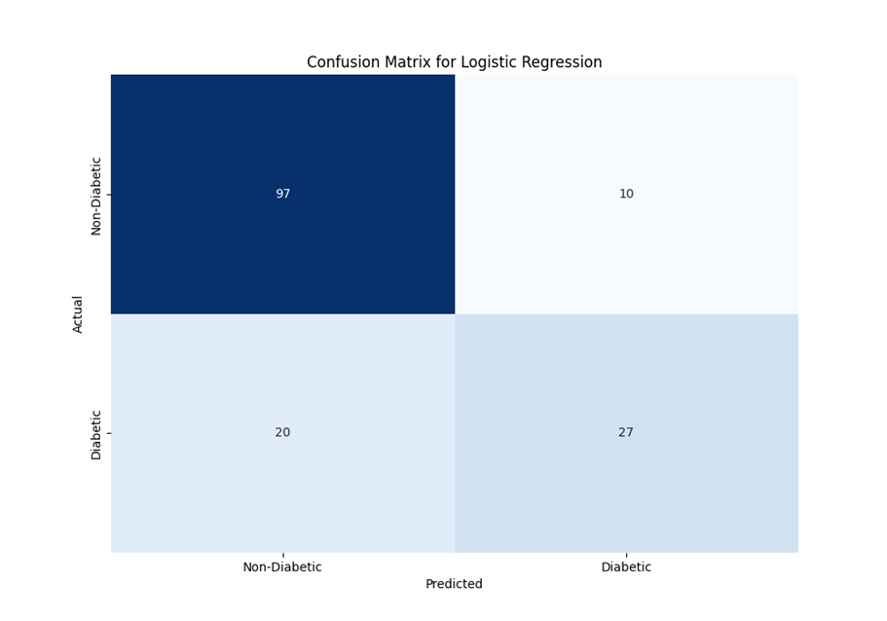
Confusion Matrix for Logistic Regression
 | Precision | Recall | F1-score | Support
0 | 0.83 | 0.91 | 0.87 | 107
1 | 0.73 | 0.57 | 0.64 | 47
Accuracy |  |  | 0.81 | 154
Macro Avg | 0.78 | 0.74 | 0.75 | 154
Weighted Avg | 0.80 | 0.81 | 0.80 | 154

Slide 18
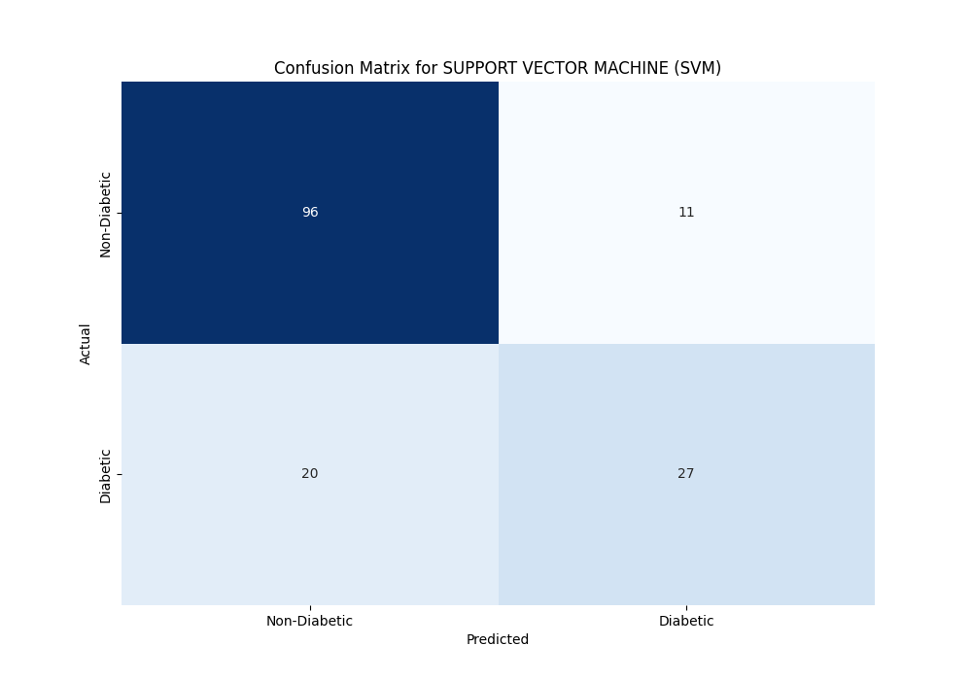
Confusion Matrix Support Vector Machine
 | Precision | Recall | F1-score | Support
0 | 0.83 | 0.90 | 0.86 | 107
1 | 0.71 | 0.57 | 0.64 | 47
Accuracy |  |  | 0.80 | 154
Macro Avg | 0.77 | 0.74 | 0.75 | 154
Weighted Avg | 0.79 | 0.80 | 0.79 | 154

Slide 19
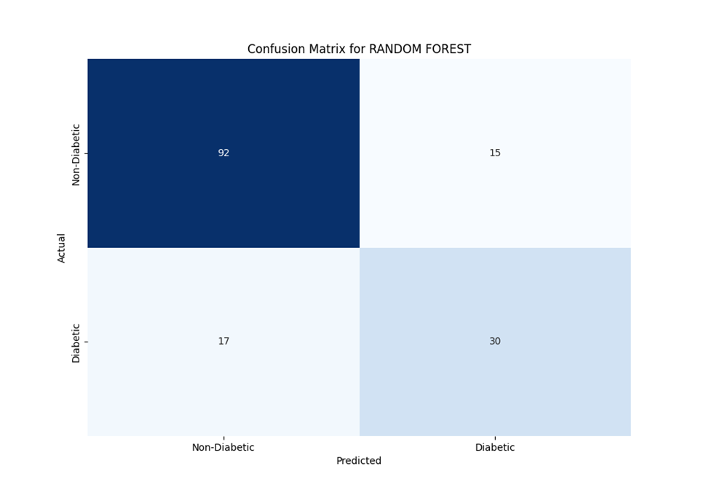
Confusion Matrix for Random Forest
 | Precision | Recall | F1-score | Support
0 | 0.84 | 0.86 | 0.85 | 107
1 | 0.67 | 0.64 | 0.65 | 47
Accuracy |  |  | 0.79 | 154
Macro Avg | 0.76 | 0.75 | 0.75 | 154
Weighted Avg | 0.79 | 0.79 | 0.79 | 154

Slide 20

Confusion Matrix K-Nearest Neighbors (KNN)
 | Precision | Recall | F1-score | Support
0 | 0.86 | 0.90 | 0.88 | 107
1 | 0.74 | 0.66 | 0.70 | 47
Accuracy |  |  | 0.82 | 154
Macro Avg | 0.80 | 0.78 | 0.79 | 154
Weighted Avg | 0.82 | 0.82 | 0.82 | 154

Slide 21
Predictive Analysis Classification
MODEL | ACCURACY (%)
Decision Tree | 78
Logistic Regression | 81
Support Vector Machine (SVM) | 80
Random Forest | 79
K-Nearest Neighbors (KNN) | 82
The K-Nearest Neighbors is the best model with the highest classification accuracy.

Slide 22
Conclusion
Features such as glucose levels, BMI, age, and Insulin levels strongly correlate with diabetes status.
Non-diabetic patients tend to be younger, with lower BMI, and smaller triceps thickness, while diabetic individuals are generally older and have higher BMI and triceps thickness.
Machine learning models trained on this dataset can effectively predict diabetes status with features like BMI and glucose providing crucial in classification.

Slide 23
After thoroughly exploring and evaluating various machine learning models on the Pima Indians dataset, the K-Nearest Neighbors (KNN) demonstrated superior performance in predicting diabetes status (82% classification accuracy).
KNN also had the best confusion matrix because it had the highest FI score for class 1(70%).

